Slide 1
SQL Injection attack
Bhavik Patel

Slide 2
Bookreview website
Create login page for book review platform.
Connect login page to database.
After successful integration of the login page perform SQL injection attack.

Slide 3
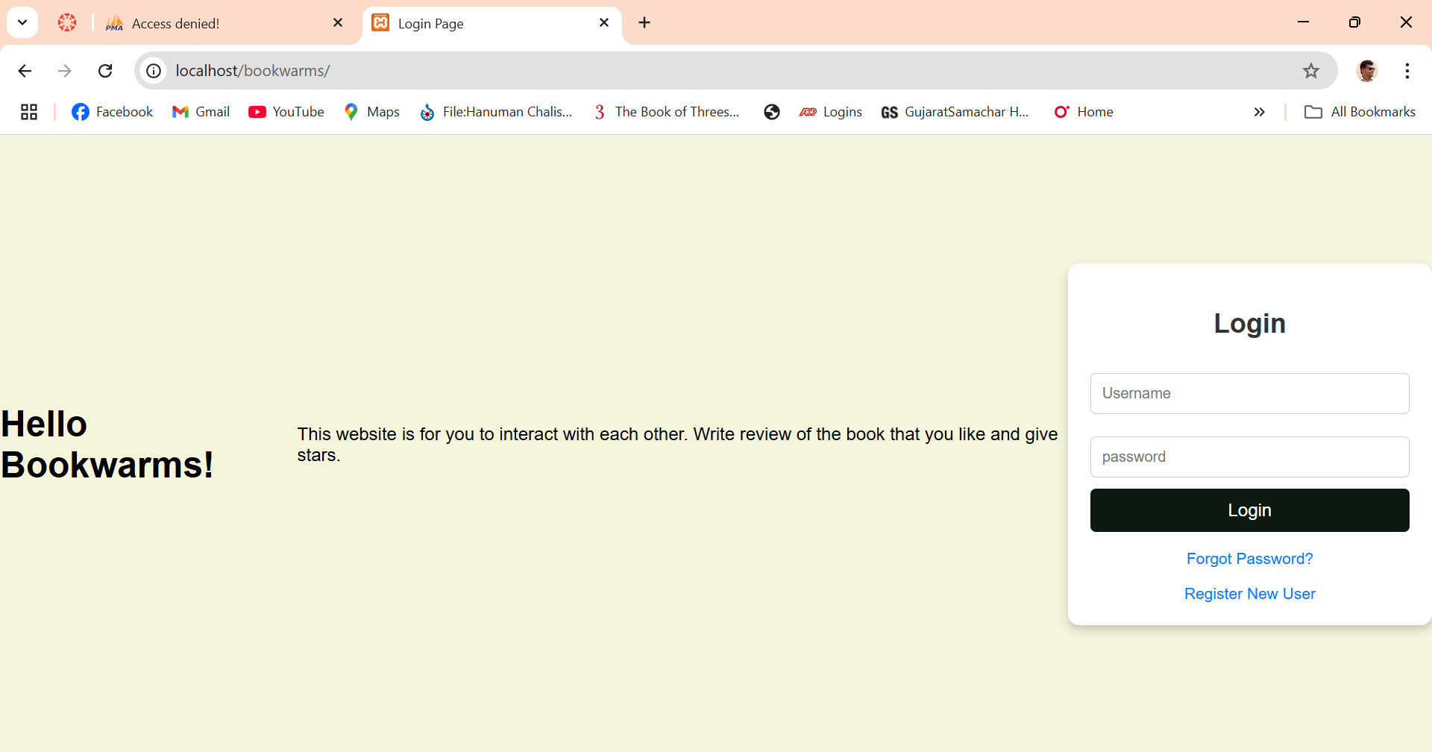
Login page

Slide 4
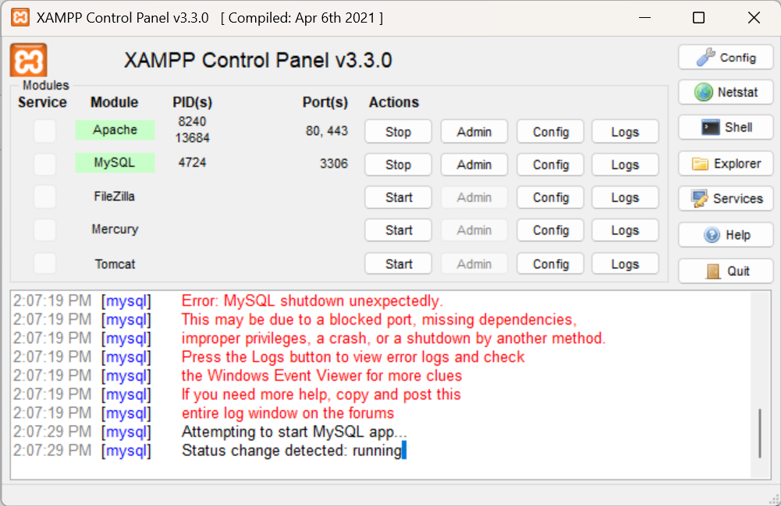
XAMPP
XAMPP is free open- source software package.
It is collection of the free software, including Apache web server, mysql, MariaDB, phpmyadmin, and filezilla

Slide 5
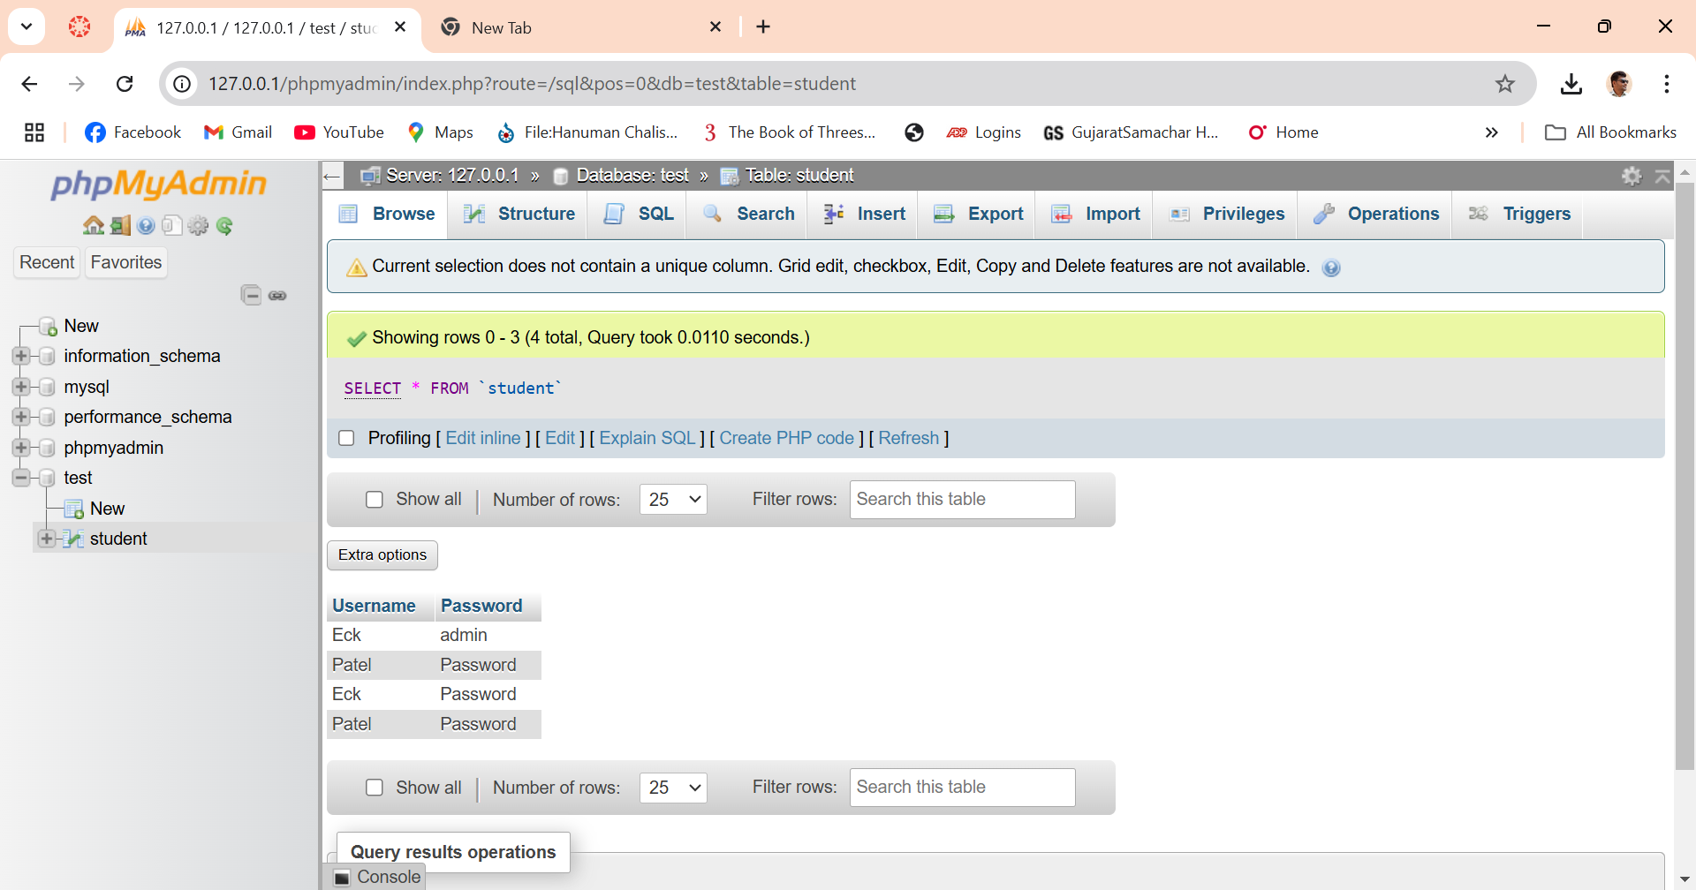
Create database in SQL

Slide 6
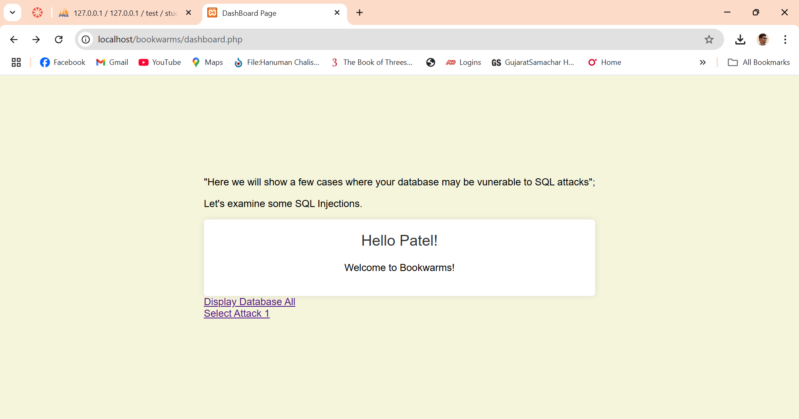
Successful login on the book review platform after login page

Slide 7

Questions?

Slide 8
Reference
digininja. (n.d.). Damn Vulnerable Web Application (DVWA) [GitHub repository]. GitHub. Retrieved fro: https://github.com/digininja/DVWA

